Slide 1
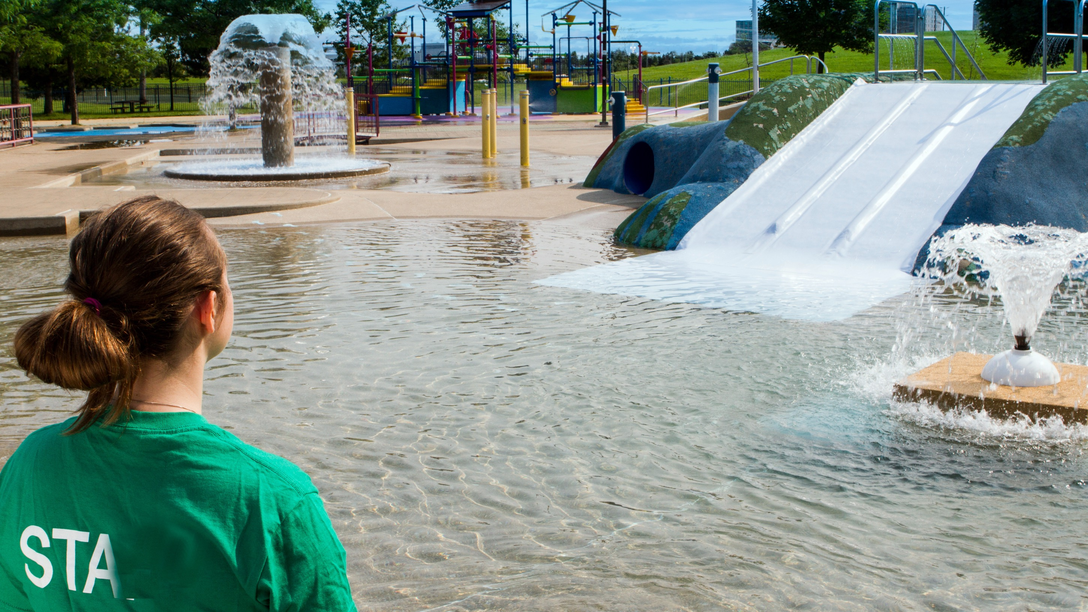

PoolAttendant

Slide 2
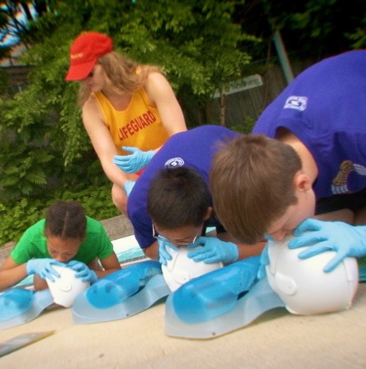

The Lifesaving Society
Training and certification: Over 1,000,000 Canadians participate in the Society’s programs every year: this includes Swim to Survive, Swim for Life, First Aid, Bronze Medal Awards, National Lifeguard and Instructor training.
Canada’s Lifeguarding Experts
Drowning prevention mission
Setting aquatic standards & research
Training beyond Pool Attendant
Charitable organization
Notes:
Purpose
To introduce the Lifesaving Society and its drowning prevention mission. To acquaint candidates with Lifesaving Society training opportunities.
Notes
The Lifesaving Society’s mission is to prevent drowning and reduce water-related injury.
Examples of training opportunities available to Pool Attendant holders include: Bronze Star, Bronze Medallion, Bronze Cross (and subsequent National Lifeguard and leadership training), first aid programs; and lifesaving sport programs and competition.
Reference:
CLM Chapter 1.4 What is the Royal Life Saving Society Canada?

Slide 3
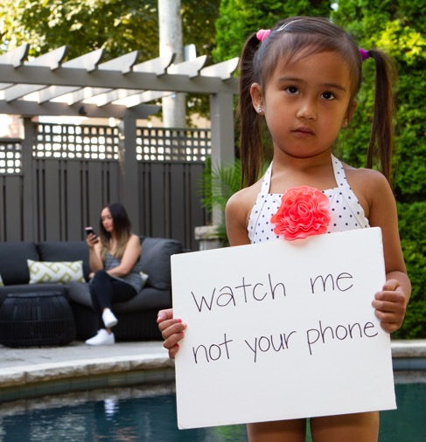
The Lifesaving Society
Public education: The Society works to make Canadians Water Smart® by focusing its drowning prevention efforts on people most at risk, e.g., parents of young children. We deliver Water Smart behavioural change messages through our Swim for Life and Swim to Survive programs.
Canada’s Lifeguarding Experts
Drowning prevention mission
Setting aquatic standards & research
Training beyond Pool Attendant
Charitable organization
Notes:
Purpose
To introduce the Lifesaving Society and its drowning prevention mission. To acquaint candidates with Lifesaving Society training opportunities.
Notes
The Lifesaving Society’s mission is to prevent drowning and reduce water-related injury.
Examples of training opportunities available to Pool Attendant holders include: Bronze Star, Bronze Medallion, Bronze Cross (and subsequent National Lifeguard and leadership training), first aid programs; and lifesaving sport programs and competition.
Reference:
CLM Chapter 1.4 What is the Royal Life Saving Society Canada?

Slide 4
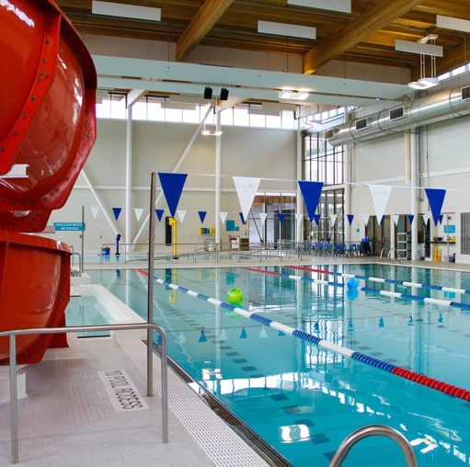
The Lifesaving Society
Aquatic safety management services: The Society establishes aquatic safety standards and consults on aquatic safety issues for the aquatic industry, governments and the judiciary. We perform aquatic safety audits and serve as experts in legal cases involving aquatic safety.
Canada’s Lifeguarding Experts
Drowning prevention mission
Setting aquatic standards & research
Training beyond Pool Attendant
Charitable organization
Notes:
Purpose
To introduce the Lifesaving Society and its drowning prevention mission. To acquaint candidates with Lifesaving Society training opportunities.
Notes
The Lifesaving Society’s mission is to prevent drowning and reduce water-related injury.
Examples of training opportunities available to Pool Attendant holders include: Bronze Star, Bronze Medallion, Bronze Cross (and subsequent National Lifeguard and leadership training), first aid programs; and lifesaving sport programs and competition.
Reference:
CLM Chapter 1.4 What is the Royal Life Saving Society Canada?

Slide 5
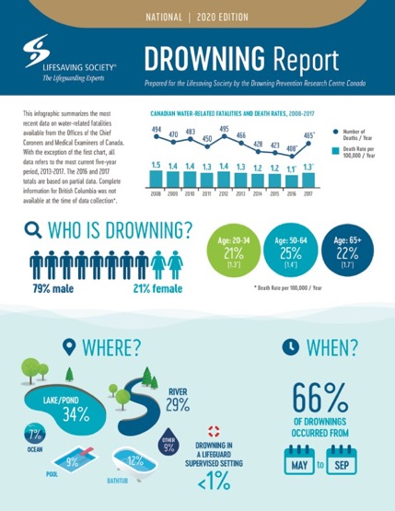
The Lifesaving Society
Drowning research: The Society conducts research into fatal and non-fatal drownings, aquatic injury and rescue interventions. Ongoing research and analysis supports evidence-based water-rescue training and prevention education.
Canada’s Lifeguarding Experts
Drowning prevention mission
Setting aquatic standards & research
Training beyond Pool Attendant
Charitable organization
Notes:
Purpose
To introduce the Lifesaving Society and its drowning prevention mission. To acquaint candidates with Lifesaving Society training opportunities.
Notes
The Lifesaving Society’s mission is to prevent drowning and reduce water-related injury.
Examples of training opportunities available to Pool Attendant holders include: Bronze Star, Bronze Medallion, Bronze Cross (and subsequent National Lifeguard and leadership training), first aid programs; and lifesaving sport programs and competition.
Reference:
CLM Chapter 1.4 What is the Royal Life Saving Society Canada?

Slide 6
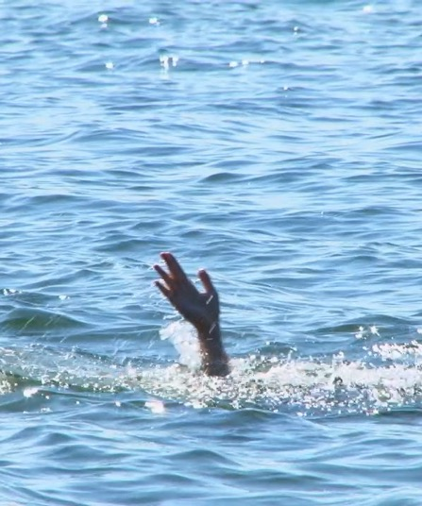
The Lifesaving Society
The Lifesaving Society offers a wide variety of training opportunities beyond Pool Attendant certification. For example, Bronze Star, Bronze Medallion, Bronze Cross, First Aid and National Lifeguard programs.
Canada’s Lifeguarding Experts
Drowning prevention mission
Setting aquatic standards & research
Training beyond Pool Attendant
Charitable organization
Notes:
Purpose
To introduce the Lifesaving Society and its drowning prevention mission. To acquaint candidates with Lifesaving Society training opportunities.
Notes
The Lifesaving Society’s mission is to prevent drowning and reduce water-related injury.
Examples of training opportunities available to Pool Attendant holders include: Bronze Star, Bronze Medallion, Bronze Cross (and subsequent National Lifeguard and leadership training), first aid programs; and lifesaving sport programs and competition.
Reference:
CLM Chapter 1.4 What is the Royal Life Saving Society Canada?

Slide 7
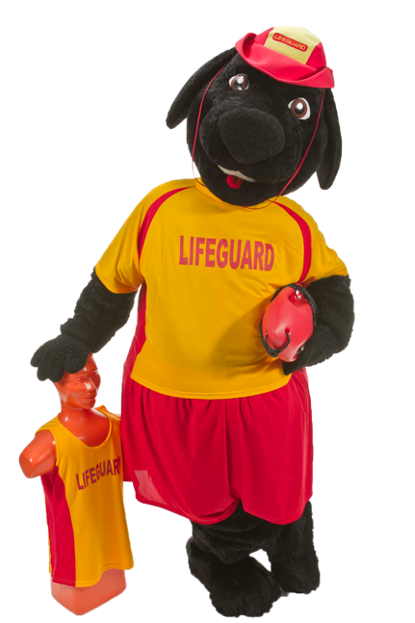
The Lifesaving Society
Woof! Buddy the lifeguard dog is the official mascot of the Lifesaving Society. Buddy is a Newfoundland breed trained to bravely save swimmers in distress.
The Lifesaving Society fundraises to bring awareness to drowning prevention.
Visit the Society’s website to find out about fundraising events in your community.
Canada’s Lifeguarding Experts
Drowning prevention mission
Setting aquatic standards & research
Training beyond Pool Attendant
Charitable organization
Notes:
Purpose
To introduce the Lifesaving Society and its drowning prevention mission. To acquaint candidates with Lifesaving Society training opportunities.
Notes
The Lifesaving Society’s mission is to prevent drowning and reduce water-related injury.
Examples of training opportunities available to Pool Attendant holders include: Bronze Star, Bronze Medallion, Bronze Cross (and subsequent National Lifeguard and leadership training), first aid programs; and lifesaving sport programs and competition.
Reference:
CLM Chapter 1.4 What is the Royal Life Saving Society Canada?

Slide 8
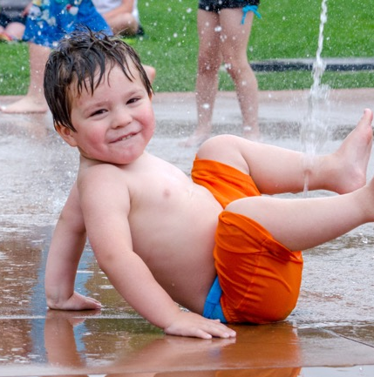
Theory and practice
Test item
Let’s learn about: The roles and responsibilities of a Pool Attendant
  Role-modelling, public relations, accident prevention, rescue response
  Operations and maintenance, challenges of working alone
Define legal obligation: duty and standard of care, liability and negligence.
Workplace and safety regulations for pool attendants.
Explain the hazardous nature of chemicals used in aquatic environments.
Documentation typically used for logging operations.
Wading pool definition
(Ontario regulations)
“public wading pool” means any structure, basin, chamber or tank containing or intended to contain an artificial body of water having a depth of water equal to 75 centimetres or less at any point, that is provided for the recreational or instructive use of young children, other than a private residential wading pool or a wading pool for display or promotional purposes only.
Notes:
Purpose
To ensure that Pool Attendants understand their role and obligations and the principles and practices inherent in their job.
Notes
In the Lifesaving Society’s training program, theoretical knowledge is best measured during practical items when performance alone often reveals the extent of the candidate’s knowledge and understanding. A separate evaluation of knowledge may be required for material not easily integrated into the test items.
Use oral evaluation and learning activities to test this knowledge – not written tests. (Written tests and homework assignments may be used as learning/teaching tools, but may not be used to evaluate a candidate’s knowledge.) Use question and answer techniques to clarify candidate performance. Base questions on Alert: Lifeguarding in Action and the Canadian Lifesaving Manual.
Reference:
Alert: Lifeguarding in Action; Canadian Lifesaving Manual; Canadian First Aid Manual
See also relevant provincial/territorial workplace health and safety regulations.

Slide 9
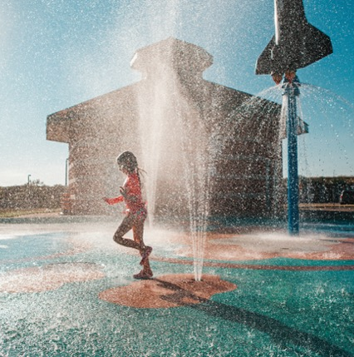
Theory and practice
Roles and responsibilities
The primary objective of a pool attendant is to prevent drowning and water-related injury, and when prevention fails, to respond quickly and professionally to prevent loss of life.
Pool attendants, assistant lifeguards and lifeguards, have a legal responsibility for the safety supervision of patrons of the aquatic facility.
Pool attendants’ roles may include working alone, or act as part of the lifeguard team – within established protocols and standard operating procedures.
Pool attendants have a duty and standard of care to maintain. Failure to maintain a standard may mean liability or negligence (failure to behave with the level of care that is expected, see next slide).
Staff training: must be provided in the operating and emergency procedures relevant to the facility. This may include: Rescue situations, Skills – scanning, Land – first aid, CPR. Additional training:
Job description, child abuse, harassment, customer service
Maintenance, workplace safety, WHMIS, sun safety
Professional code of conduct
Notes:
Notes
In the Lifesaving Society’s training program, theoretical knowledge is best measured during practical items when performance alone often reveals the extent of the candidate’s knowledge and understanding. A separate evaluation of knowledge may be required for material not easily integrated into the test items.
Use oral evaluation and learning activities to test this knowledge – not written tests. (Written tests and homework assignments may be used as learning/teaching tools, but may not be used to evaluate a candidate’s knowledge.) Use question and answer techniques to clarify candidate performance. Base questions on Alert: Lifeguarding in Action and the Canadian Lifesaving Manual.
Reference:
Alert: Lifeguarding in Action; Canadian Lifesaving Manual; Canadian First Aid Manual
See also relevant provincial/territorial workplace health and safety regulations.

Slide 10
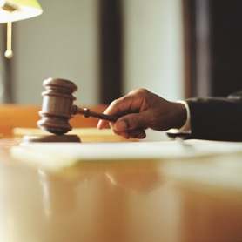
Theory and practice
Legal obligations
Duty of care: obligations or rights are created between an individual and person responsible.
  When a Pool Attendant opens the doors to patrons they are obligated to ensure a safe environment for swimmers and have a duty to respond to emergencies
Standard of care: means a person is obligated to take care as any “reasonable person” would.
  Pool Attendants who adhere to the Lifesaving Society standards and employer practices are likely performing at or above the standard of care expected of any reasonable
  person trained as a Pool Attendant
Negligence: defined – carelessness or the failure to behave in the manner expected by the community. To prove negligence, these three items must be covered:
Duty of care was owed
Reasonable standard of care was not met
Actions caused damage to person or property
Notes:
Notes
In the Lifesaving Society’s training program, theoretical knowledge is best measured during practical items when performance alone often reveals the extent of the candidate’s knowledge and understanding. A separate evaluation of knowledge may be required for material not easily integrated into the test items.
Use oral evaluation and learning activities to test this knowledge – not written tests. (Written tests and homework assignments may be used as learning/teaching tools, but may not be used to evaluate a candidate’s knowledge.) Use question and answer techniques to clarify candidate performance. Base questions on Alert: Lifeguarding in Action and the Canadian Lifesaving Manual.
Reference:
Alert: Lifeguarding in Action; Canadian Lifesaving Manual; Canadian First Aid Manual
See also relevant provincial/territorial workplace health and safety regulations.

Slide 11
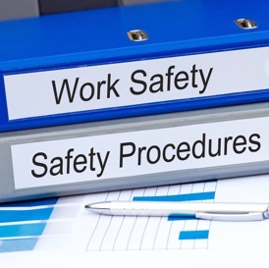
Theory and practice
Laws and regulations
Provincial regulations: When you accept a position at a public pool, it is important you understand your responsibilities under the law. When put “in charge,” even on part-time basis, you are legally responsible for meeting the requirements.
WHMIS: Canada’s Workplace Hazardous Materials Information System (WHMIS) is a comprehensive system for providing health and safety information on hazardous products intended for use, handling, or storage in Canadian workplaces.
  MSDS: Operators (Pool Attendants) should be provided with personal protective equipment (mask, gloves, aprons and boots) for the purpose of storing and handling chemicals and Material Safety Data Sheets (MSDS), which outline relevant information.
Provincial regulations: e.g., Guide to Ontario Public Pools Regulation, defines regulations for public pools, wading pools, spas, spray pads, and receiving basins.
Check with your employer regarding specific provincial regulations and local by-laws.
Notes:
Notes
In the Lifesaving Society’s training program, theoretical knowledge is best measured during practical items when performance alone often reveals the extent of the candidate’s knowledge and understanding. A separate evaluation of knowledge may be required for material not easily integrated into the test items.
Use oral evaluation and learning activities to test this knowledge – not written tests. (Written tests and homework assignments may be used as learning/teaching tools, but may not be used to evaluate a candidate’s knowledge.) Use question and answer techniques to clarify candidate performance. Base questions on Alert: Lifeguarding in Action and the Canadian Lifesaving Manual.
Reference:
Alert: Lifeguarding in Action; Canadian Lifesaving Manual; Canadian First Aid Manual
See also relevant provincial/territorial workplace health and safety regulations.

Slide 12
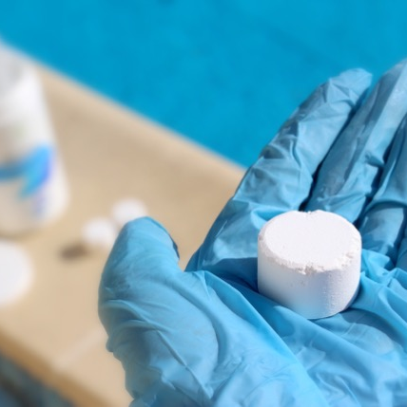
Theory and practice
Chemicals in aquatic settings
Pool Attendants should ensure:
  Chemicals are clearly labelled and stored in a safe and secure location that is inaccessible to the public and bathers
  There is a safe distance between different types of chemicals to avoid accidental mixing of dangerous chemicals
  The type and amount of chemicals added manually
Chemicals such as chlorine and muriatic acid should be stored separately where they cannot leak and interact with each other. Signage should identify each chemical.
When mixing chemicals, add them slowly. Never add water to the chemicals, always add the chemical to the water.
General safe practices: Store chemicals in a cool, dry and ventilated area, including:
Have personal protective equipment available as required
Do not eat, drink or smoke in the chemical storage area
Keep containers closed when chemicals are not in use
Always wash hands thoroughly after handling chemicals
Material Safety Data Sheets (MSDS) must be made available to employees for every chemical in use
Notes:
Notes
In the Lifesaving Society’s training program, theoretical knowledge is best measured during practical items when performance alone often reveals the extent of the candidate’s knowledge and understanding. A separate evaluation of knowledge may be required for material not easily integrated into the test items.
Use oral evaluation and learning activities to test this knowledge – not written tests. (Written tests and homework assignments may be used as learning/teaching tools, but may not be used to evaluate a candidate’s knowledge.) Use question and answer techniques to clarify candidate performance. Base questions on Alert: Lifeguarding in Action and the Canadian Lifesaving Manual.
Reference:
Alert: Lifeguarding in Action; Canadian Lifesaving Manual; Canadian First Aid Manual
See also relevant provincial/territorial workplace health and safety regulations.

Slide 13
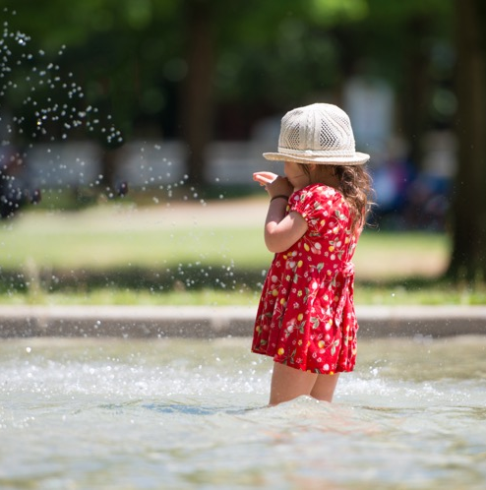
Theory and practice
Working alone at a wading pool
When EMS is needed: Follow the written emergency procedures from the employer for direct access to activating EMS. If a life-threatening emergency does occur, attendants may recruit additional help from nearby patrons certified in first aid.
Breaks: Pool Attendants should know and understand the type and frequency of breaks permitted by their employer. Pool must be cleared if Pool Attendant leaves their post.
Ask questions: Pool Attendants should be comfortable and encouraged to reach out to their supervisors or other staff members whenever questions or situations arise that are not easily answered.
Stay alert: Pool Attendants ensure a safe and enjoyable aquatic experience through the vigilant supervision of patrons.
Notes:
Notes
In the Lifesaving Society’s training program, theoretical knowledge is best measured during practical items when performance alone often reveals the extent of the candidate’s knowledge and understanding. A separate evaluation of knowledge may be required for material not easily integrated into the test items.
Use oral evaluation and learning activities to test this knowledge – not written tests. (Written tests and homework assignments may be used as learning/teaching tools, but may not be used to evaluate a candidate’s knowledge.) Use question and answer techniques to clarify candidate performance. Base questions on Alert: Lifeguarding in Action and the Canadian Lifesaving Manual.
Reference:
Alert: Lifeguarding in Action; Canadian Lifesaving Manual; Canadian First Aid Manual
See also relevant provincial/territorial workplace health and safety regulations.

Slide 14

Theory and practice
Documentation and logging include
Pool Attendants are responsible for documenting and logging daily information concerning the function and operation of the wading pool. This may include:
  Bather load – how many bathers visit during the morning and afternoon
  Pool chemistry, e.g., chlorine and pH levels
  Water clarity, e.g., good or poor, is the bottom visible
  Fouling, e.g., feces, vomit, blood or chemical
  Filtration or circulation system is not operative or malfunctioning
  Drain cover or fittings missing or not in good repair
  Ground Fault Circuit Interrupter missing or malfunctioning (if applicable)
  Emergency communication device is not available or malfunctioning
  Health and safety: inclement weather, electrical storm concern
Notes:
Notes
Documentation including but not limited to: bather load, incidents/accidents/injuries, fouling’s, customer complaints and maintenance logs (e.g., pH, chlorine, water clarity and weather)
In the Lifesaving Society’s training program, theoretical knowledge is best measured during practical items when performance alone often reveals the extent of the candidate’s knowledge and understanding. A separate evaluation of knowledge may be required for material not easily integrated into the test items.
Use oral evaluation and learning activities to test this knowledge – not written tests. (Written tests and homework assignments may be used as learning/teaching tools, but may not be used to evaluate a candidate’s knowledge.) Use question and answer techniques to clarify candidate performance. Base questions on Alert: Lifeguarding in Action and the Canadian Lifesaving Manual.
Reference:
Alert: Lifeguarding in Action; Canadian Lifesaving Manual; Canadian First Aid Manual
See also relevant provincial/territorial workplace health and safety regulations.

Slide 15
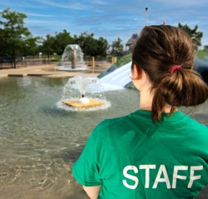
Communication
Test item
Let’s learn about: Demonstrating effective communication with
Patrons and victims:
    Provide good customer service and public relations
    Educate and explain safe practices
    Personal modelling of safe practices
Coworkers, supervisors & EMS:
    Demonstrate hand and whistle signals
    Can give and receive accurate directions
    Clear and accurate communication
Notes:
Purpose
To develop positive communication skills required by Pool Attendants.
Notes
Stress that appropriate communication – whether with patrons or with fellow staff members – is always professional and respectful.
Both active listening (e.g., paraphrasing, clarifying, summarizing) and clear communication are essential skills. Respect and empathy for others are reflected in listening skills. Provide as many opportunities as possible for candidates to practice these skills throughout the course
Provide candidates with the following suggestions: confront the problem and stay focused; deal with the problem, not the person; don’t argue; listen attentively and clarify your understanding of the person’s view; avoid being defensive; shift from the complaint to problem resolution.
Create situations normally encountered on a regular basis. Incorporate diverse populations (e.g., various ethnic origins, ages, disabilities) in these situations.
Emphasize that attendants must respect their employer’s policies and protocols concerning abuse, harassment and confidentiality.
Teach the use of a variety of communication techniques (e.g., whistles, hand signals, radios). Stress the importance of standardizing whistle and hand signals among all members of the aquatic team.
Reference:
Alert Chapter 3: Alert Chapter 3 Aquatic Emergencies: Communication with emergency services

Slide 16
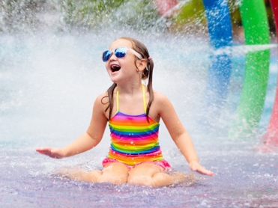
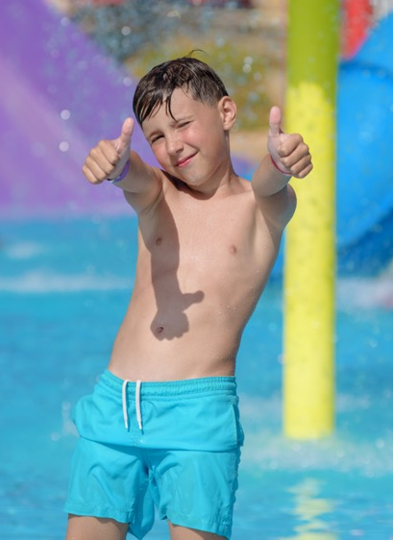
Communication
With patrons
The Pool Attendant’s challenge is to maximize patrons’ fun while minimizing their risk of injury. Good public relations results in positive patron attitudes and behaviour.
The goal should be to persuade patrons to see the pool attendant as someone who is professional, approachable, and eager to help.
Learn to convey information calmly, clearly, and accurately. Ensure all communication with patrons is respectful.
Practice effective listening skills to ensure that you accurately receive information.
Verbal communication: Move as close to the patron as possible. Lower yourself to the patron’s physical level and use respectful language.
Notes:
Notes
Stress that appropriate communication – whether with patrons or with fellow staff members – is always professional and respectful.
Both active listening (e.g., paraphrasing, clarifying, summarizing) and clear communication are essential skills. Respect and empathy for others are reflected in listening skills. Provide as many opportunities as possible for candidates to practice these skills throughout the course
Provide candidates with the following suggestions: confront the problem and stay focused; deal with the problem, not the person; don’t argue; listen attentively and clarify your understanding of the person’s view; avoid being defensive; shift from the complaint to problem resolution.
Create situations normally encountered on a regular basis. Incorporate diverse populations (e.g., various ethnic origins, ages, disabilities) in these situations.
Emphasize that attendants must respect their employer’s policies and protocols concerning abuse, harassment and confidentiality.
Teach the use of a variety of communication techniques (e.g., whistles, hand signals, radios). Stress the importance of standardizing whistle and hand signals among all members of the aquatic team.
Reference:
Alert Chapter 3: Alert Chapter 3 Aquatic Emergencies: Communication with emergency services

Slide 17

Communication
Public relations
A Pool Attendant’s behaviour and image
Body language, e.g., stance while patrolling and scanning the wading pool
Vigilant and attentive, professional, alert
Uniforms kept neat, clean, appropriately worn
Model expected attitudes and behaviours
Develop a rapport with patrons, get to know their name
Notes:
Notes
Stress that appropriate communication – whether with patrons or with fellow staff members – is always professional and respectful.
Both active listening (e.g., paraphrasing, clarifying, summarizing) and clear communication are essential skills. Respect and empathy for others are reflected in listening skills. Provide as many opportunities as possible for candidates to practice these skills throughout the course
Provide candidates with the following suggestions: confront the problem and stay focused; deal with the problem, not the person; don’t argue; listen attentively and clarify your understanding of the person’s view; avoid being defensive; shift from the complaint to problem resolution.
Create situations normally encountered on a regular basis. Incorporate diverse populations (e.g., various ethnic origins, ages, disabilities) in these situations.
Emphasize that attendants must respect their employer’s policies and protocols concerning abuse, harassment and confidentiality.
Teach the use of a variety of communication techniques (e.g., whistles, hand signals, radios). Stress the importance of standardizing whistle and hand signals among all members of the aquatic team.
Reference:
Alert Chapter 3: Alert Chapter 3 Aquatic Emergencies: Communication with emergency services

Slide 18
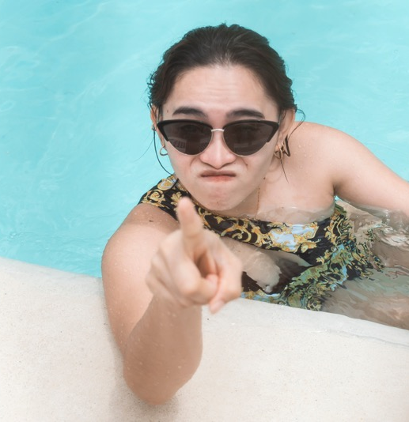
Communication
Confronting complaints or problems
Introduce yourself and ask the patron’s name, set the tone.
Listen. Fully and patiently hear the person out.
Try to understand the complaint from the patron’s view.
Demonstrate that you have heard the complaint by paraphrasing it.
Remain objective and neutral, investigate if needed.
Shifting complaint to problem-solving by identifying what steps will be taken next, follow up with supervisor if needed.
Notes:
Notes
Stress that appropriate communication – whether with patrons or with fellow staff members – is always professional and respectful.
Both active listening (e.g., paraphrasing, clarifying, summarizing) and clear communication are essential skills. Respect and empathy for others are reflected in listening skills. Provide as many opportunities as possible for candidates to practice these skills throughout the course
Provide candidates with the following suggestions: confront the problem and stay focused; deal with the problem, not the person; don’t argue; listen attentively and clarify your understanding of the person’s view; avoid being defensive; shift from the complaint to problem resolution.
Create situations normally encountered on a regular basis. Incorporate diverse populations (e.g., various ethnic origins, ages, disabilities) in these situations.
Emphasize that attendants must respect their employer’s policies and protocols concerning abuse, harassment and confidentiality.
Teach the use of a variety of communication techniques (e.g., whistles, hand signals, radios). Stress the importance of standardizing whistle and hand signals among all members of the aquatic team.
Reference:
Alert Chapter 3: Alert Chapter 3 Aquatic Emergencies: Communication with emergency services

Slide 19
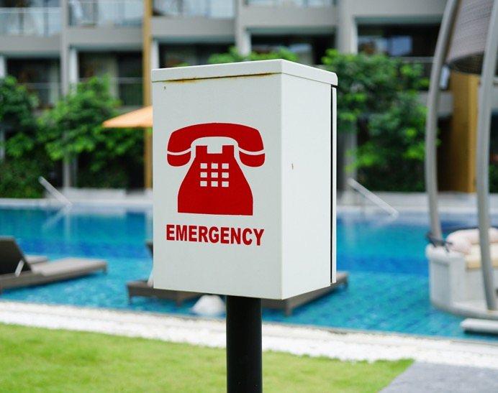
Communication
Coworkers, supervisors & EMS – procedures
Emergency procedures – major vs. minor
Procedure for a major emergency: a process for responding to an urgent and life-threatening incident. Usually involves more than one staff, e.g., seizure victim convulsing in water.
Procedure for a minor emergency: a process for responding to a non life-threatening incident. However, in some cases if not handled promptly may become a major emergency, e.g., distressed swimmer.
Notes:
Notes
Stress that appropriate communication – whether with patrons or with fellow staff members – is always professional and respectful.
Both active listening (e.g., paraphrasing, clarifying, summarizing) and clear communication are essential skills. Respect and empathy for others are reflected in listening skills. Provide as many opportunities as possible for candidates to practice these skills throughout the course
Provide candidates with the following suggestions: confront the problem and stay focused; deal with the problem, not the person; don’t argue; listen attentively and clarify your understanding of the person’s view; avoid being defensive; shift from the complaint to problem resolution.
Create situations normally encountered on a regular basis. Incorporate diverse populations (e.g., various ethnic origins, ages, disabilities) in these situations.
Emphasize that attendants must respect their employer’s policies and protocols concerning abuse, harassment and confidentiality.
Teach the use of a variety of communication techniques (e.g., whistles, hand signals, radios). Stress the importance of standardizing whistle and hand signals among all members of the aquatic team.
Reference:
Alert Chapter 3: Alert Chapter 3 Aquatic Emergencies: Communication with emergency services

Slide 20
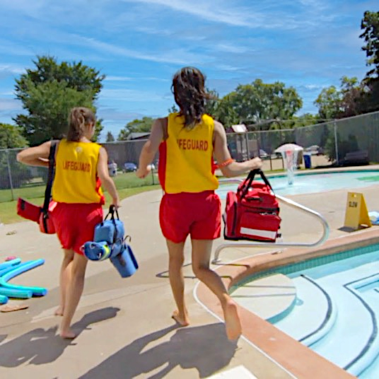
Communication
Coworkers, supervisors & EMS – major
Procedure for a major emergency:
  1st Pool Attendant / Lifeguard’s role: identify incident
    signal to other staff, e.g., one long whistle blast
    respond to victim, assess and support A-B-Cs
  2nd Pool Attendant / Lifeguard role: go to assist 1st Pool Attendant / Lifeguard
    back up 1st staff – victim support, A-B-Cs
    if only one staff, ensure water is cleared, EMS contact
  3rd Pool Attendant / Lifeguard role:
    complete evacuation of pool area
    contact EMS, bring first aid supplies, obtain info, etc.
Notes:
Notes
Teach the use of a variety of communication techniques (e.g., whistles, hand signals, radios). Stress the importance of standardizing whistle and hand signals among all members of the aquatic team.
Reference:
Alert Chapter 3: Alert Chapter 3 Aquatic Emergencies: Communication with emergency services

Slide 21
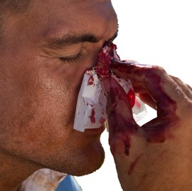
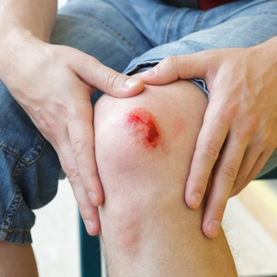
Communication
Coworkers, supervisors & EMS – minor
Procedure for a minor emergency:
  1st Pool Attendant / Lifeguard role
    identifies incident, e.g. public relations question(s)
    signals to other Pool Attendant / Lifeguard(s) minor incident, e.g., two short whistle blasts and/or hand signal
  2nd Pool Attendant / Lifeguard role
    signals to other Pool Attendant / Lifeguards minor incident is underway, comes to alert stance with arm raised to side
    moves to cover 1st Pool Attendant / Lifeguard zone
    ready to provide backup if needed
Notes:
Notes
Teach the use of a variety of communication techniques (e.g., whistles, hand signals, radios). Stress the importance of standardizing whistle and hand signals among all members of the aquatic team.
Reference:
Alert Chapter 3: Alert Chapter 3 Aquatic Emergencies: Communication with emergency services

Slide 22
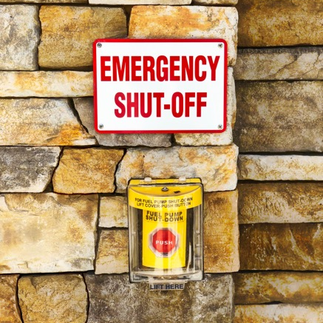
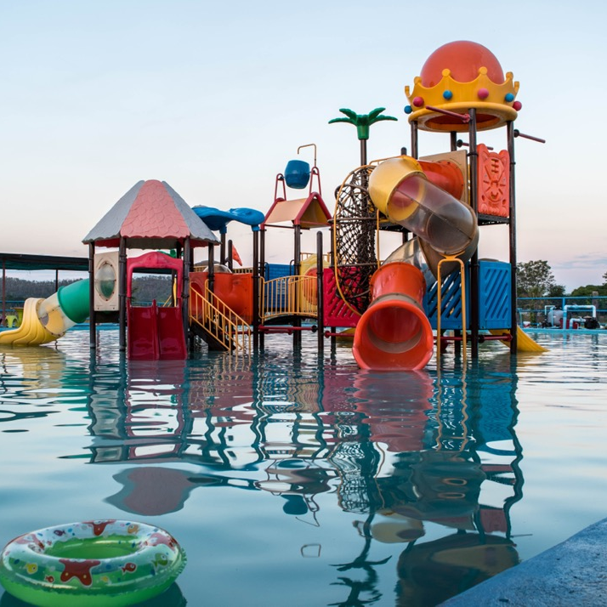
Communication
Coworkers, supervisors & EMS – single attendant
Single Pool Attendant:
  Adapt emergency procedures, e.g.:
    emergency button available to call auxiliary staff
    auxiliary staff are trained to provide backup
    pool must be cleared if lifeguard leaves their post
Bystanders:
  May assist with crowd control, bringing first aid supplies, gathering information on what happened, etc.
  Be calm, confident and direct with specific instructions.

Slide 23

Communication
With victims
What to say: As soon as practical, learn the victim’s name and use it. Introduce yourself by name and let the victim know you are a Pool Attendant. Tell the victim what you are going to do before you do it. Ask permission.
The manner in which you communicate may have a calming effect. How you say something may be as important as what you say. Calm, relaxed, and decisive movements and gestures help reassure a victim.
The following are the types of questions (both open-ended and specific) that may provide useful information:
  “Are you okay?” “What’s the problem?”
  “What’s your name?” “Has this happened before?”
  “Do you hurt anywhere else?”
  “Do you have any medical problems we should know about?”
Notes:
Notes
Stress that appropriate communication – whether with patrons or with fellow staff members – is always professional and respectful.
Both active listening (e.g., paraphrasing, clarifying, summarizing) and clear communication are essential skills. Respect and empathy for others are reflected in listening skills. Provide as many opportunities as possible for candidates to practice these skills throughout the course
Teach the use of a variety of communication techniques (e.g., whistles, hand signals, radios). Stress the importance of standardizing whistle and hand signals among all members of the aquatic team.
See Communications, pg. XX
Reference:
Alert Chapter 3: Alert Chapter 3 Aquatic Emergencies: Communication with emergency services

Slide 24
Aquatic facility analysis
Test item
Let’s learn about: Demonstrating an understanding of the following
Features that vary from wading pool to wading pool (or from time to time) and how analysis of these affects their job.
The role of water treatment systems in providing a safe and comfortable bather environment.
Environmental hazards of wading pools, amusement devices and play structures.
Inspection and operation of waterslides, amusement devices and play structures.
Notes:
Purpose
To introduce Pool Attendants to common waterpark features, related potential hazards and basic safety protocols.
Notes
Dangers and hazards may include glare, water quality, evacuations due to weather, sun, lack of hydration and fouling.
Response may include education of patrons about hazards or safer activity choices: marking, removing or modifying hazards to reduce risk; or repositioning.
Candidates should be aware of WHMIS and pool operator training programs available.
Reference:
Alert Chapter 11 Swimming Pool Operation and Safety

Slide 25
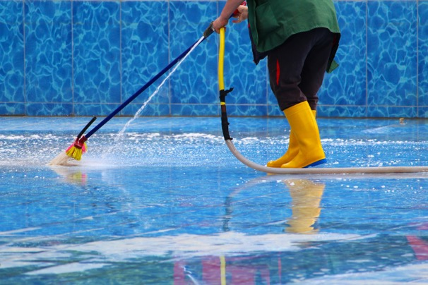
Aquatic facility analysis
Types of wading pools
There are two common types of wading pools:
Fill and dump means a pool that is filled with water prior to use each day and drained after use each day.
  Generally, there is no filtration system for this type of wading pool
  There is no standing water when the pool is not in use and the main drain is left open when the pool is closed
Filtered means a system that maintains circulation of water through a pool by pumps, draws water from a pool for treatment and returns it to the pool as clean water, and provides continuous treatment.
  Includes filtration and chlorination or bromination and other processes necessary for the treatment of water
Notes:
Notes
Dangers and hazards may include glare, water quality, evacuations due to weather, sun, lack of hydration and fouling.
Response may include education of patrons about hazards or safer activity choices: marking, removing or modifying hazards to reduce risk; or repositioning.
Candidates should be aware of WHMIS and pool operator training programs available.
Reference:
Alert Chapter 11 Swimming Pool Operation and Safety

Slide 26
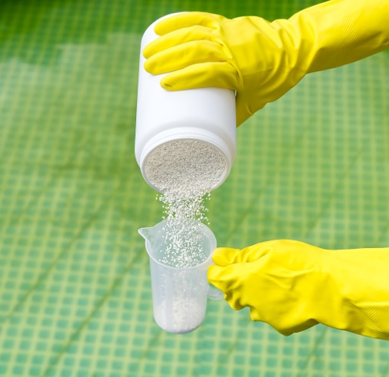
Aquatic facility analysis
Chemical treatment of water
Chlorine & bromine: used to destroy bacteria and prevent algae growth.
Residual chlorine or bromine: is the total amount of chlorine or bromine available to destroy bacteria. Also called free available chlorine FAC:
  Maintain free available chlorine from 0.8 to 1.5 p.p.m.
  Maintain free available bromine at 2.0 p.p.m.
Chlorine effectiveness: depends mainly on
  Level of bacteria; chlorine is used up as it attacks bacteria
  Amount of direct sunlight; breaks chemical bonds
  Water agitation, splashing, etc.; breaks chemical bonds
Notes:
Notes
Dangers and hazards may include glare, water quality, evacuations due to weather, sun, lack of hydration and fouling.
Response may include education of patrons about hazards or safer activity choices: marking, removing or modifying hazards to reduce risk; or repositioning.
Candidates should be aware of WHMIS and pool operator training programs available.
Reference:
Alert Chapter 11 Swimming Pool Operation and Safety

Slide 27
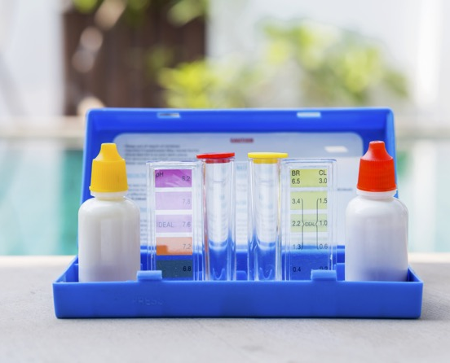
Aquatic facility analysis
Chemical treatment of water – pH
Maintaining comfortable water levels:
pH: water measured as
  Acidic 1.0 to 7.0 range
  Alkaline or basic 7.0 to 14.0 range
  Neutral water 7.0 neither acidic nor basic
pH between 7.2 to 7.8
High pH can cause discolouration of water, gritty/itchy irritation of swimmers eyes
Low pH causes corrosion of pipes and drains. Can change colour of hair that has been dyed
pH outside 7.2 to 7.8 reduces effectiveness of chlorine/bromine
Notes:
Notes
Dangers and hazards may include glare, water quality, evacuations due to weather, sun, lack of hydration and fouling.
Response may include education of patrons about hazards or safer activity choices: marking, removing or modifying hazards to reduce risk; or repositioning.
Candidates should be aware of WHMIS and pool operator training programs available.
Reference:
Alert Chapter 11 Swimming Pool Operation and Safety

Slide 28

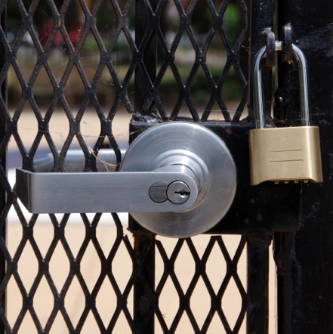
Aquatic facility analysis
Environmental hazards
Pool Attendants usually follow a checklist of typical tasks when opening and closing wading pools, inspecting waterslides, amusement devices, and play structures such as:
Opening checklist: emergency phone, first aid kits, testing pool water and clarity, checking circuit breakers, checking for lose tiles, checking waterslide for cracks or defects, etc.
Closing checklist: securing chemicals, locking doors or gates, cleaning up deck and hanging up wet items or equipment, making a log entry of events for the day, etc.
Notes:
Notes
Dangers and hazards may include glare, water quality, evacuations due to weather, sun, lack of hydration and fouling.
Response may include education of patrons about hazards or safer activity choices: marking, removing or modifying hazards to reduce risk; or repositioning.
Candidates should be aware of WHMIS and pool operator training programs available.
Reference:
Alert Chapter 11 Swimming Pool Operation and Safety

Slide 29
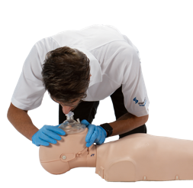
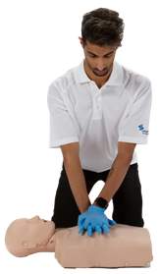
Drowning resuscitation
Test item
Let’s learn what to do: On a manikin, demonstrate single-rescuer adult, child, and infant drowning resuscitation including ability to deal with with complications
  Assess environment, unresponsiveness, EMS activation
  Attempt to obtain an AED and an AED-trained responder
  Appropriate use of barrier devices
  Victim positioned on back, open airway, check for breathing
  CPR started with rescue breaths (drowning victim); application of AED (if available) at earliest possible moment
  Ability to deal with complication
  (e.g., vomit, gastric distention)
Notes:
Purpose
To restore breathing and circulation in an unconscious drowning victim with absent or abnormal breathing.
Notes
A drowning victim requires oxygen fast. The rescuer’s priority is the immediate provision of ventilation. With a drowning victim, rescuers start CPR with two rescue breathes followed by compressions.
Candidates are encouraged to use mobile technology for quick activation of EMS.
Rescuers, who may be the AED-trained responder, should understand the importance of early defibrillation and how to use an AED (components, activation and pad application).
“Signs of life” might include victim movement or victim breathing on their own.
Reference:
CLM Chapter 7.2 The ABC Priorities; 7.4 Rescue Breathing; 7.5 CPR and AED; Chapter 8.3 Airway and Breathing Problems (Aspiration); Appendix B The Society’s Policy Guidelines on Rescue Breathing Practice; CFAM Primary Emergencies; AED and Airway Management

Slide 30
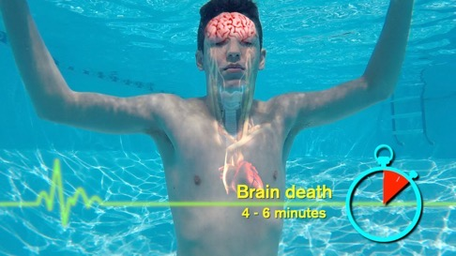
Drowning resuscitation
Breaths first
Drowning outcomes can be fatal or non-fatal
  Drowning victims can suffocate when the airway is blocked by water. As a result, vital organs in the body (the heart and brain) receive insufficient oxygen levels to function effectively.
  The primary cause of death from drowning is suffocation – a lack of oxygen. A drowning victim requires oxygen fast.
  Providing first aid care for an unconscious drowning victim requires CPR. The first and most important treatment is the immediate provision of ventilations.
  Start CPR with rescue breaths first, followed by compressions.
Notes:
Notes
A drowning victim requires oxygen fast. The rescuer’s priority is the immediate provision of ventilation. With a drowning victim, rescuers start CPR with two rescue breathes followed by compressions.
Candidates are encouraged to use mobile technology for quick activation of EMS.
Rescuers, who may be the AED-trained responder, should understand the importance of early defibrillation and how to use an AED (components, activation and pad application).
“Signs of life” might include victim movement or victim breathing on their own.
Reference:
CLM Chapter 7.2 The ABC Priorities; 7.4 Rescue Breathing; 7.5 CPR and AED; Chapter 8.3 Airway and Breathing Problems (Aspiration); Appendix B The Society’s Policy Guidelines on Rescue Breathing Practice; CFAM Primary Emergencies; AED and Airway Management

Slide 31
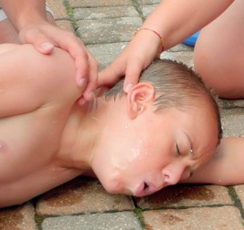
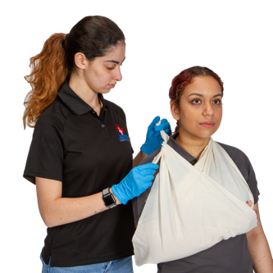
Victim recognition
Test item
Let’s learn how to develop awareness of the appearance and capabilities of victims in need of different kinds of assistance:
  Ability to identify common types of distressed swimmers or drowning victims
  Ability to identify patrons in need of assistance due to heat, cold or circulatory emergencies, anaphylaxis, seizure disorder
Notes:
Purpose
To develop awareness of the appearance and capabilities of victims in need of different kinds of assistance.
Notes
Realistic demonstration of victim types is important in lifesaving training because rescuers need to be able to recognize when someone needs help – and what kind of help they need.
Do not fault candidates for failing to recognize victim types when the victim portrayal is inaccurate.
Reference:
CLM Chapter 4.3 Victim Recognition

Slide 32
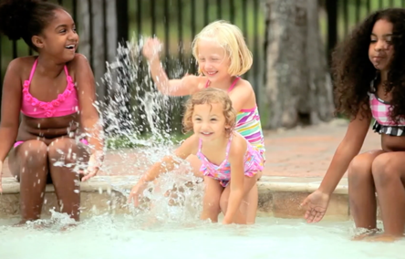
Victim recognition
What to look for
Distressed victims
  Tries to swim, may show signs of pain, seen holding their breath, face shows fear, attempts to communicate
Drowning victims
  Does not call for help or wave, non-supportive leg action, vigorous arm movements, head tilted back or face downward, face shows panic
Looking for trouble
  Remember to intervene and prevent a drowning incident if possible
Most drowning victims among under 5-year-olds are 2- to 4-year-olds
  They are inquisitive and take advantage of their ever-expanding range and speed of mobility. They have no awareness of looming aquatic danger
  Drowning is a silent killer and can happen in as little as 10 seconds. Parents and caregivers must be within arms' reach of their children whenever they are near water – in the backyard, at the beach, and in the bathroom
Notes:
Notes
Realistic demonstration of victim types is important in lifesaving training because rescuers need to be able to recognize when someone needs help – and what kind of help they need.
Do not fault candidates for failing to recognize victim types when the victim portrayal is inaccurate.
Reference:
CLM Chapter 4.3 Victim Recognition

Slide 33
Spinal injury management
Test item
Let’s learn what to do: Respond to a breathing or non-breathing suspected spinal-injured victim located in shallow water or on land
Single-rescuer skill – not a rescue
Use of spineboard not required or evaluated
Victim located in shallow water or on land
If face down in water, smooth turnover
Quick recognition, EMS activation, bystander direction, appropriate entry and approach, turnover if necessary, ABCs assessed, CPR started immediately if victim non-breathing
Notes:
Purpose
To demonstrate the management of a victim with a suspected spinal injury.
Notes
This is a single-rescuer skill demonstration, not a rescue.
Use of a spineboard is not a requirement of this item and candidates are not evaluated on its use.
Recognition is based on an understanding of mechanism of injury.
Victim may be face up or face down.
Non-breathing victim removed from water with bystander assistance.
Reference:
CLM Chapter 5.10 Rescue Procedures for Spinal Injuries; Chapter 7.2 The ABC Priorities; Chapter

Slide 34
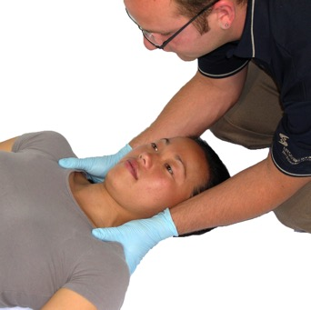
Spinal injury management
Mechanism of injury and rollovers
Spinal injuries can result from severe head injuries, falls, crashes, diving head first into shallow water hitting the bottom, jack-knifing of back or other water activities.
Techniques for rollover and immobilization involve the alignment or realignment of the head in the neutral position (the victims nose is in a straight line with their belly button).
Types of rollover and immobilization techniques, shallow water:
  Canadian rollover and reverse Canadian rollover
  Vice grip rollover
  Trapezius squeeze
Notes:
Notes
This is a single-rescuer skill demonstration, not a rescue.
Use of a spineboard is not a requirement of this item and candidates are not evaluated on its use.
Recognition is based on an understanding of mechanism of injury.
Victim may be face up or face down.
Non-breathing victim removed from water with bystander assistance.
Reference:
CLM Chapter 5.10 Rescue Procedures for Spinal Injuries; Chapter 7.2 The ABC Priorities; Chapter

Slide 35
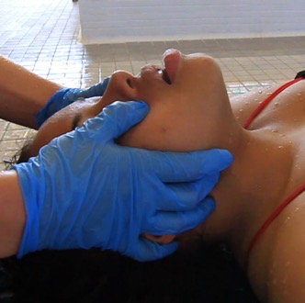
Spinal injury management
Mechanism of injury and rollovers
ABC complications
  Immobilization is maintained as long as possible under the circumstances, for one lifeguard it may not be possible
  If victim is unresponsive and non-breathing, immediate CPR is required
  If the victim is found in the water and is not breathing, start with two rescue breaths. Remove the victim promptly to start CPR.
To open airway attempt jaw thrust, if unsuccessful use head-tilt chin-lift. Check ABCs often.
Notes:
Notes
This is a single-rescuer skill demonstration, not a rescue.
Use of a spineboard is not a requirement of this item and candidates are not evaluated on its use.
Recognition is based on an understanding of mechanism of injury.
Victim may be face up or face down.
Non-breathing victim removed from water with bystander assistance.
Reference:
CLM Chapter 5.10 Rescue Procedures for Spinal Injuries; Chapter 7.2 The ABC Priorities; Chapter

Slide 36
Surveillance: positioning and rotation
Test item
Let’s learn about: Demonstrating effective wading pool supervision using positioning and rotation
Appropriate pool attendant positioning with consideration for:
  Facility features
  Danger (high-risk) areas and blind spots, e.g., around waterslides
  Bather load and number of pool attendants on duty
  Changes in number of patrons or pool attendants
  Location of equipment
  Leisure equipment and patron activity
  Changes in visibility
Effective pool attendant rotation while maintaining effective coverage
Notes:
Purpose
To develop an understanding of the factors that influence effective positioning. To develop an appreciation for the characteristics of efficient rotation and the importance of maintaining constant surveillance.
Notes
Design scenarios to practice and evaluate positioning (and repositioning) and rotation skills. Public relations or rescue responses are not required in this item.
Stress that roving Pool Attendants maintain visual contact with the water at all times.
Emphasize that “buddy watching / lifeguarding” reduces the effectiveness of supervision and must be avoided. See RID factors in Alert: Lifeguarding in Action.
What Instructors should know:
Experience is a very good teacher. Over time, pool attendants develop a discerning eye and nose for potential trouble.
Experienced attendants develop good pattern recognition skills and are faster at detecting disturbances or anomalies in those patters that new
Training and practice will help prepare the new attendant for those early days on the job
If you are unsure of something you are seeing in the water, don’t hesitate, and respond (it’s better to be safe than sorry)
Learning Activity:
- Based on what you have learned regarding scanning, come up with a list together as a group of things to look out for.
Reference:
Alert Chapter 2 Accident Prevention: Facility analysis and supervision

Slide 37
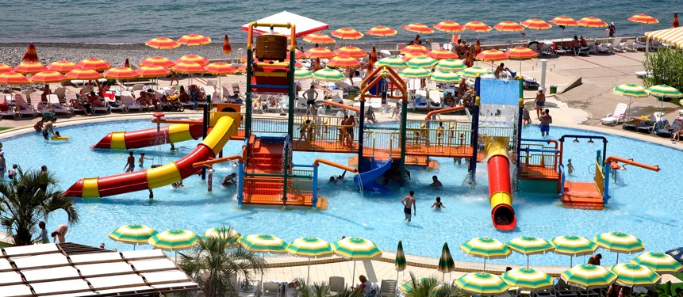
Surveillance
Positioning
Position Pool Attendants to ensure effective supervision of entire facility, consider:
Type of zone(s) used
Sight lines: determine best position to see in front, field of view to see entire zone, e.g., corner position or V-shape
Elevated stations: provides broader view, helps with reduced effects of refraction or glare to see below surface
Ground-level patrol: closer to patrons for enforcement of safety rules and public relations, can assist with blind spots
Facility features, danger areas, number of patrons, type of leisure equipment or activity, changes in visibility, e.g., waterfalls, spray nozzles
Shifting for cover: attendant signals other attendants / lifeguards to cover their area and shift to leave no gaps in supervision
Notes:
Notes
Design scenarios to practice and evaluate positioning (and repositioning) and rotation skills. Public relations or rescue responses are not required in this item.
Stress that roving pool attendants maintain visual contact with the water at all times.
Emphasize that “buddy watching / lifeguarding” reduces the effectiveness of supervision and must be avoided. See RID factors in Alert: Lifeguarding in Action.
What Instructors should know:
Experience is a very good teacher. Over time, pool attendants develop a discerning eye and nose for potential trouble.
Experienced attendants develop good pattern recognition skills and are faster at detecting disturbances or anomalies in those patters that new
Training and practice will help prepare the new attendant for those early days on the job
If you are unsure of something you are seeing in the water, don’t hesitate, and respond (it’s better to be safe than sorry)
Learning Activity:
- Based on what you have learned regarding scanning, come up with a list together as a group of things to look out for.
Reference:
Alert Chapter 2 Accident Prevention: Facility analysis and supervision

Slide 38
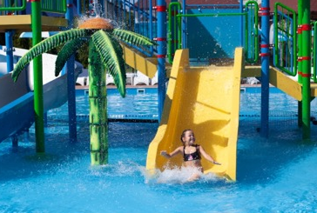
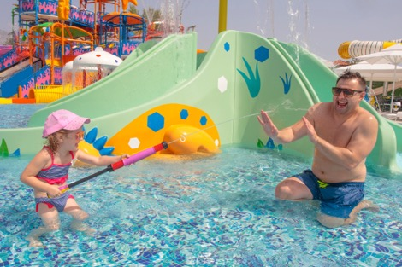
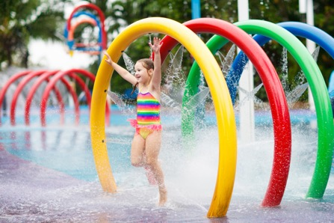
Surveillance
Rotation
Rotations and breaks help with
  Keeping alert by providing variety and relief from demands of a single post.
  Rotations occur at a specific time. One attendant moves at a time. The Pool Attendant at the least demanding post rotates to the most demanding post typically.
  If a break is included in the rotation, the Pool Attendant coming from the break usually relieves the Pool Attendant with the most demanding post.
  Rotations allow for information sharing about potential hazards or noteworthy activities in that zone.
Notes:
Notes
Design scenarios to practice and evaluate positioning (and repositioning) and rotation skills. Public relations or rescue responses are not required in this item.
Stress that roving pool attendants maintain visual contact with the water at all times.
Emphasize that “buddy watching / lifeguarding” reduces the effectiveness of supervision and must be avoided. See RID factors in Alert: Lifeguarding in Action.
What Instructors should know:
Experience is a very good teacher. Over time, pool attendants develop a discerning eye and nose for potential trouble.
Experienced attendants develop good pattern recognition skills and are faster at detecting disturbances or anomalies in those patters that new
Training and practice will help prepare the new attendant for those early days on the job
If you are unsure of something you are seeing in the water, don’t hesitate, and respond (it’s better to be safe than sorry)
Learning Activity:
- Based on what you have learned regarding scanning, come up with a list together as a group of things to look out for.
Reference:
Alert Chapter 2 Accident Prevention: Facility analysis and supervision

Slide 39
Surveillance: scanning and observation
Test item
Let’s learn about: Demonstrating effective pool supervision using observation skills and scanning techniques
  Systematic scanning pattern with observable head movement
  Continuous scan of designated supervision zone including wading pool bottom
  Quick, accurate recognition and analysis of potential incidents and of patrons needing assistance
  Recognition of communication from other staff (e.g., hand or whistle signals) if applicable
Notes:
Purpose
To develop the skills required to effectively support Pool Attendant surveillance of wading pool amenities.
Notes
Design scenarios to practice and evaluate scanning techniques and observation skills. Ask candidates to describe what they are seeing as they scan. Rescue response is not a requirement of this item.
Use a manikin to teach scanning of the pool bottom.
Designated supervision zone means the specific area for which the Pool Attendant has been assigned supervisory responsibility. The designated supervision zone may or may not include the wading pool deck or a section of deck.
A Pool Attendant should be able to effectively scan his or her assigned zone within a window of 10 to 30 seconds.
Speed of recognition depends on a variety of factors including size of the scanning zone; area of activity; bather load; facility design.
What Instructors should know: Effective scanning assumes that pool attendants can see the entire area, that they know what they are looking for, and that they will recognize it when the see it
Pool attendants must be positioned with clear, unobstructed sight lines
Pool attendants must move to counteract patron interference (especially in ground-level supervision)
Pool attendants must take steps to minimize the effect of reflection or glare (eg. Change position, use polarized sunglasses)
Pool attendants scanning strategy must compensate for an inability to see below the surface and for distance from patron activity
Pool attendants must practice to develop and improve perception skills
Pool attendants must understand the signs of potential trouble, and the characteristic behaviours of those in need of help
Even if there are only a few people swimming, or they are all in one small area of the pool, pool attendants must still scan their ENTIRE zone and surround deck.
Reference:
Alert Chapter 2 Accident Prevention: Facility analysis and supervision

Slide 40
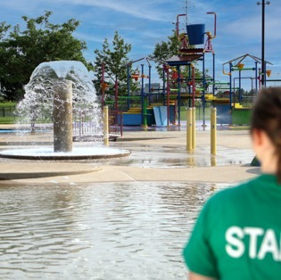
Surveillance: scanning and observation
How to scan
Scanning
  Sweep zone with your eyes, moving your head side to side
  A scan should take 10 seconds but no longer than 30 seconds
  In pools, scan the bottom first, then the surface
  Look and listen for the unusual
  Avoid staring at the same thing
  Focus on peoples’ faces and what they are doing, make eye contact
  Give your eyes a break, focus momentarily on some distant object
  Never stop scanning when speaking with a patron
  At outdoor facilities, monitor changes in environmental conditions
Notes:
Notes
Design scenarios to practice and evaluate scanning techniques and observation skills. Ask candidates to describe what they are seeing as they scan. Rescue response is not a requirement of this item.
Use a manikin to teach scanning of the pool bottom.
Designated supervision zone means the specific area for which the pool attendant has been assigned supervisory responsibility. The designated supervision zone may or may not include the wading pool deck or a section of deck.
A pool attendant should be able to effectively scan his or her assigned zone within a window of 10 to 30 seconds.
Speed of recognition depends on a variety of factors including size of the scanning zone; area of activity; bather load; facility design.
What Instructors should know: Effective scanning assumes that pool attendants can see the entire area, that they know what they are looking for, and that they will recognize it when the see it
Pool attendants must be positioned with clear, unobstructed sight lines
Pool attendants must move to counteract patron interference (especially in ground-level supervision)
Pool attendants must take steps to minimize the effect of reflection or glare (eg. Change position, use polarized sunglasses)
Pool attendants scanning strategy must compensate for an inability to see below the surface and for distance from patron activity
Pool attendants must practice to develop and improve perception skills
Pool attendants must understand the signs of potential trouble, and the characteristic behaviours of those in need of help
Even if there are only a few people swimming, or they are all in one small area of the pool, pool attendants must still scan their ENTIRE zone and surround deck.
Reference:
Alert Chapter 2 Accident Prevention: Facility analysis and supervision

Slide 41
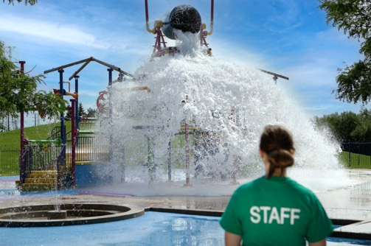
Surveillance: scanning and observation
Effective scanning means Pool Attendants can see the entire area; they know what they are looking for and recognize it when seen
Scanning is affected by:
  Number of patrons and their activities
  Number of staff and their location
  Facility design and layout
  Supervision zone, shape and size
  Lighting conditions
Notes:
Notes
Design scenarios to practice and evaluate scanning techniques and observation skills. Ask candidates to describe what they are seeing as they scan. Rescue response is not a requirement of this item.
Use a manikin to teach scanning of the pool bottom.
Designated supervision zone means the specific area for which the pool attendant has been assigned supervisory responsibility. The designated supervision zone may or may not include the wading pool deck or a section of deck.
A pool attendant should be able to effectively scan his or her assigned zone within a window of 10 to 30 seconds.
Speed of recognition depends on a variety of factors including size of the scanning zone; area of activity; bather load; facility design.
What Instructors should know: Effective scanning assumes that pool attendants can see the entire area, that they know what they are looking for, and that they will recognize it when the see it
Pool attendants must be positioned with clear, unobstructed sight lines
Pool attendants must move to counteract patron interference (especially in ground-level supervision)
Pool attendants must take steps to minimize the effect of reflection or glare (eg. Change position, use polarized sunglasses)
Pool attendants scanning strategy must compensate for an inability to see below the surface and for distance from patron activity
Pool attendants must practice to develop and improve perception skills
Pool attendants must understand the signs of potential trouble, and the characteristic behaviours of those in need of help
Even if there are only a few people swimming, or they are all in one small area of the pool, pool attendants must still scan their ENTIRE zone and surround deck.
Reference:
Alert Chapter 2 Accident Prevention: Facility analysis and supervision

Slide 42
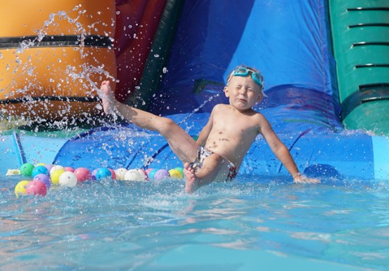
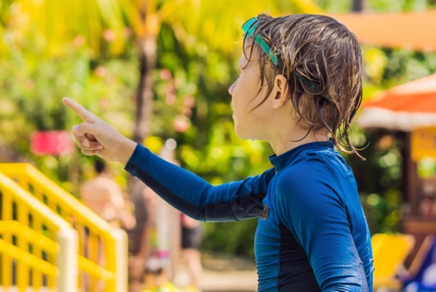
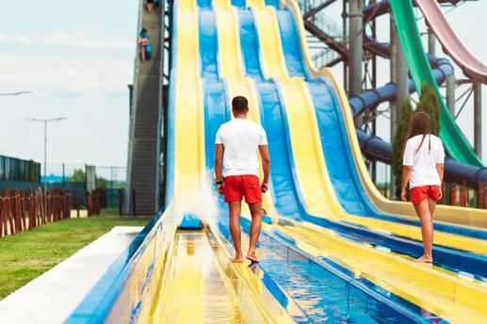
Surveillance: scanning and observation
R.I.D
R.I.D. factor: drownings in supervised areas are typically a result of one or a combination of:
  A failure to Recognize the signs of distress
    Know and scan for the signs of a drowning victim
  Intrusion of non-Pool Attendant / Lifeguard duties
    Performing clean-up, paperwork or other duties, which intrude from active Pool Attendant / Lifeguarding duties
  Distraction from surveillance duties
    Talking at length with patrons, “buddy lifeguarding,” (e.g., chatting with other staff)
Notes:
Notes
Design scenarios to practice and evaluate scanning techniques and observation skills. Ask candidates to describe what they are seeing as they scan. Rescue response is not a requirement of this item.
Use a manikin to teach scanning of the pool bottom.
Designated supervision zone means the specific area for which the pool attendant has been assigned supervisory responsibility. The designated supervision zone may or may not include the wading pool deck or a section of deck.
A pool attendant should be able to effectively scan his or her assigned zone within a window of 10 to 30 seconds.
Speed of recognition depends on a variety of factors including size of the scanning zone; area of activity; bather load; facility design.
What Instructors should know: Effective scanning assumes that pool attendants can see the entire area, that they know what they are looking for, and that they will recognize it when the see it
Pool attendants must be positioned with clear, unobstructed sight lines
Pool attendants must move to counteract patron interference (especially in ground-level supervision)
Pool attendants must take steps to minimize the effect of reflection or glare (eg. Change position, use polarized sunglasses)
Pool attendants scanning strategy must compensate for an inability to see below the surface and for distance from patron activity
Pool attendants must practice to develop and improve perception skills
Pool attendants must understand the signs of potential trouble, and the characteristic behaviours of those in need of help
Even if there are only a few people swimming, or they are all in one small area of the pool, pool attendants must still scan their ENTIRE zone and surround deck.
Reference:
Alert Chapter 2 Accident Prevention: Facility analysis and supervision

Slide 43
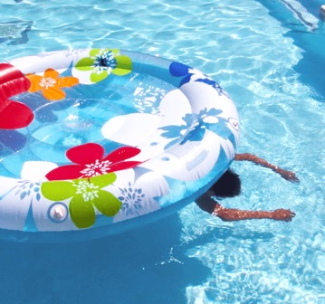
Surveillance: scanning and observation
How to scan
Continuously sweep your eyes over you zone, moving your head to the right and left, looking behind you, in front and below.
The pool bottom is a priority, respond immediately to any unusual shadows, smudges or dark object below the surface.
Attend to “hot spots” like amusement devices, bottom of waterslides, spray nozzles, etc. Include adjacent staff when scanning.
Focus on people and what they are doing. Make eye contact whenever possible. Watch facial expression.
Look and listen for unusual behavior.
Never stop scanning when speaking with a patron. Signal for back up if needed.
Notes:
Notes
Design scenarios to practice and evaluate scanning techniques and observation skills. Ask candidates to describe what they are seeing as they scan. Rescue response is not a requirement of this item.
Use a manikin to teach scanning of the pool bottom.
Designated supervision zone means the specific area for which the pool attendant has been assigned supervisory responsibility. The designated supervision zone may or may not include the wading pool deck or a section of deck.
A pool attendant should be able to effectively scan his or her assigned zone within a window of 10 to 30 seconds.
Speed of recognition depends on a variety of factors including size of the scanning zone; area of activity; bather load; facility design.
What Instructors should know: Effective scanning assumes that pool attendants can see the entire area, that they know what they are looking for, and that they will recognize it when the see it
Pool attendants must be positioned with clear, unobstructed sight lines
Pool attendants must move to counteract patron interference (especially in ground-level supervision)
Pool attendants must take steps to minimize the effect of reflection or glare (eg. Change position, use polarized sunglasses)
Pool attendants scanning strategy must compensate for an inability to see below the surface and for distance from patron activity
Pool attendants must practice to develop and improve perception skills
Pool attendants must understand the signs of potential trouble, and the characteristic behaviours of those in need of help
Even if there are only a few people swimming, or they are all in one small area of the pool, pool attendants must still scan their ENTIRE zone and surround deck.
Reference:
Alert Chapter 2 Accident Prevention: Facility analysis and supervision

Slide 44
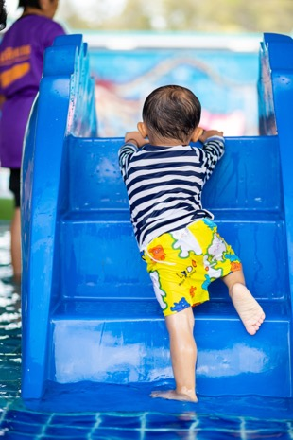
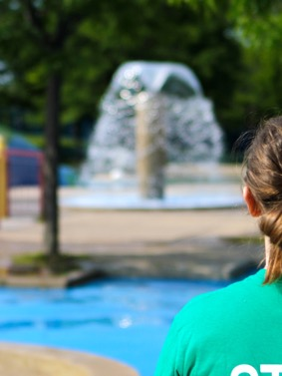
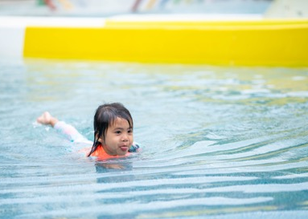
Surveillance: scanning and observation
Common techniques for scanning
Head counting: know the number of patrons and if the number changes, find out why
Grouping: sort patrons by age, sex, risk potential, etc., and monitor changes
Mental filing: build patron profiles based on swimming ability, skill, activity, and track changes
Profile matching: measure what you see against the profiles of potential trouble or victim types
Tracking: track the progress of individuals, who submerge and those who fit the high-risk profile
Scanning patterns: Starburst / Arching / Zig-Zag
Notes:
Notes
Design scenarios to practice and evaluate scanning techniques and observation skills. Ask candidates to describe what they are seeing as they scan. Rescue response is not a requirement of this item.
Use a manikin to teach scanning of the pool bottom.
Designated supervision zone means the specific area for which the pool attendant has been assigned supervisory responsibility. The designated supervision zone may or may not include the wading pool deck or a section of deck.
A pool attendant should be able to effectively scan his or her assigned zone within a window of 10 to 30 seconds.
Speed of recognition depends on a variety of factors including size of the scanning zone; area of activity; bather load; facility design.
What Instructors should know: Effective scanning assumes that pool attendants can see the entire area, that they know what they are looking for, and that they will recognize it when the see it
Pool attendants must be positioned with clear, unobstructed sight lines
Pool attendants must move to counteract patron interference (especially in ground-level supervision)
Pool attendants must take steps to minimize the effect of reflection or glare (eg. Change position, use polarized sunglasses)
Pool attendants scanning strategy must compensate for an inability to see below the surface and for distance from patron activity
Pool attendants must practice to develop and improve perception skills
Pool attendants must understand the signs of potential trouble, and the characteristic behaviours of those in need of help
Even if there are only a few people swimming, or they are all in one small area of the pool, pool attendants must still scan their ENTIRE zone and surround deck.
Reference:
Alert Chapter 2 Accident Prevention: Facility analysis and supervision

Slide 45
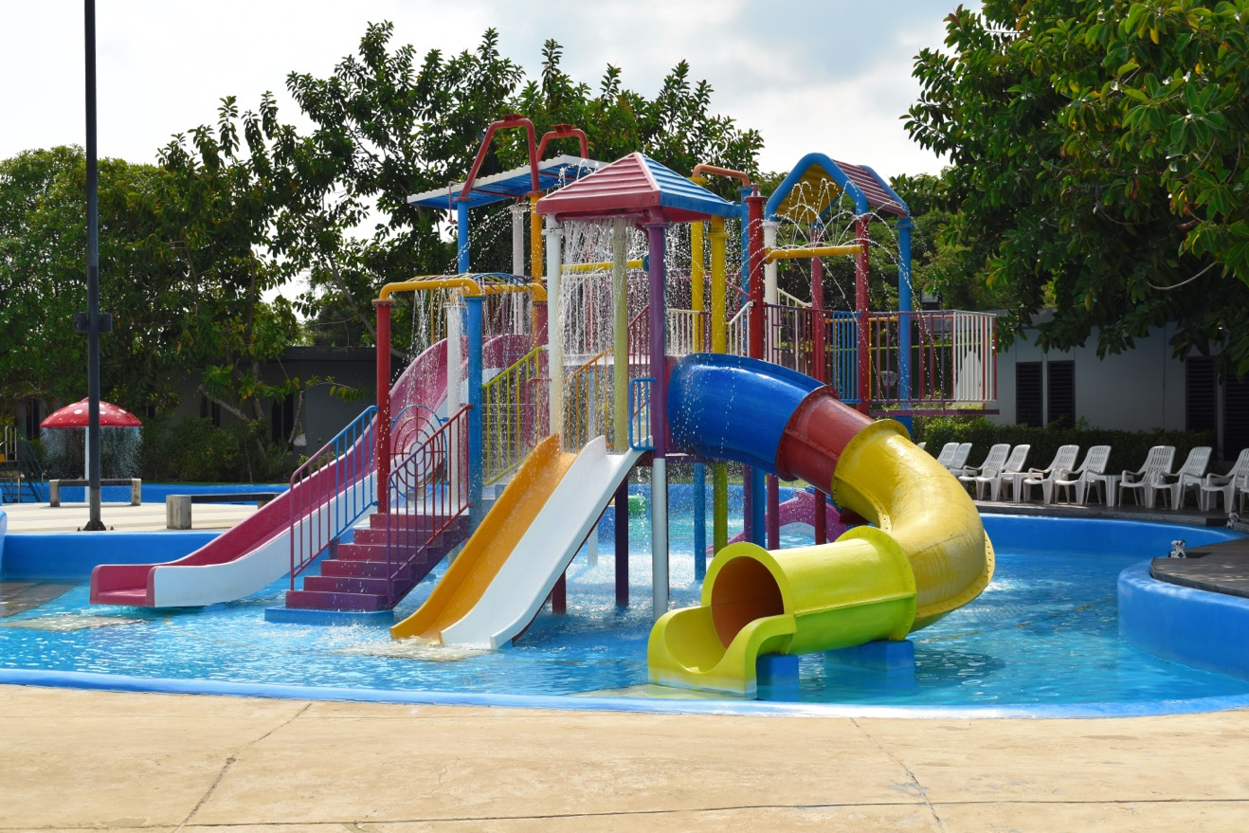
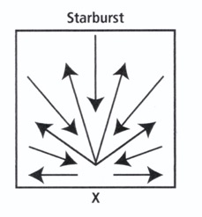


Surveillance: scanning and observation
Scanning patterns
Notes:
Notes
Design scenarios to practice and evaluate scanning techniques and observation skills. Ask candidates to describe what they are seeing as they scan. Rescue response is not a requirement of this item.
Use a manikin to teach scanning of the pool bottom.
Designated supervision zone means the specific area for which the pool attendant has been assigned supervisory responsibility. The designated supervision zone may or may not include the wading pool deck or a section of deck.
A pool attendant should be able to effectively scan his or her assigned zone within a window of 10 to 30 seconds.
Speed of recognition depends on a variety of factors including size of the scanning zone; area of activity; bather load; facility design.
What Instructors should know: Effective scanning assumes that pool attendants can see the entire area, that they know what they are looking for, and that they will recognize it when the see it
Pool attendants must be positioned with clear, unobstructed sight lines
Pool attendants must move to counteract patron interference (especially in ground-level supervision)
Pool attendants must take steps to minimize the effect of reflection or glare (eg. Change position, use polarized sunglasses)
Pool attendants scanning strategy must compensate for an inability to see below the surface and for distance from patron activity
Pool attendants must practice to develop and improve perception skills
Pool attendants must understand the signs of potential trouble, and the characteristic behaviours of those in need of help
Even if there are only a few people swimming, or they are all in one small area of the pool, pool attendants must still scan their ENTIRE zone and surround deck.
Reference:
Alert Chapter 2 Accident Prevention: Facility analysis and supervision

Slide 46
Surveillance: prevention and intervention
Test item
Let’s learn about: Demonstrating an ability to recognize situations in which early intervention may prevent a rescue emergency
Quick, accurate recognition of high-risk behaviours and activities
Appropriate intervention and education
Notes:
Purpose
To develop the early-recognition skills necessary to prevent incidents.
Notes
The intent of this item is to recognize and intervene before an incident occurs. Pool Attendant response should be proactive and timely to prevent the situation from escalating or deteriorating.
Stress that appropriate Pool Attendant communication – whether with patrons or with fellow staff members – is always professional and respectful.
Teaching and evaluation may include use of situations, role-playing scenarios, observation exercises, or other practical assignments.
Candidates should not simulate behaviours that will place them at risk.
Refer to Alert: Lifeguarding in Action for a list of potential victims, behaviours and characteristics.
Reference:
Alert Chapter 2 Accident Prevention; Facility analysis and supervision; Chapter 3 Aquatic Emergencies: Recognition and intervention

Slide 47



Surveillance: intervention
Pool Attendants should recognize and intervene before an incident occurs. Look for trouble such as:
Unusual gestures or facial expressions
Weak swimmers
Unsupervised children
Swimmers who do not want their face wet
Medical alert jewellery on patrons
Rough play
Dare devils
Notes:
Purpose
To develop the early-recognition skills necessary to prevent incidents.
Notes
The intent of this item is to recognize and intervene before an incident occurs. Pool attendant response should be proactive and timely to prevent the situation from escalating or deteriorating.
Stress that appropriate pool attendant communication – whether with patrons or with fellow staff members – is always professional and respectful.
Teaching and evaluation may include use of situations, role-playing scenarios, observation exercises, or other practical assignments.
Candidates should not simulate behaviours that will place them at risk.
Refer to Alert: Lifeguarding in Action for a list of potential victims, behaviours and characteristics.
Reference:
Alert Chapter 2 Accident Prevention; Facility analysis and supervision; Chapter 3 Aquatic Emergencies: Recognition and intervention

Slide 48

Management of an injured victim
Test item
Let’s learn what to do: demonstrate effective management of an injured victim
Quick recognition and immediate response
Appropriate selection and effective demonstration of rescue techniques
Effective communication (reassurance) with victim
Effective communication with waterpark staff including activation of the emergency action plan
Appropriate selection and proper use of equipment including barrier devices
Victim removal with assistance (if required)
ABC assessment and appropriate first aid treatment
Victim information collected for incident report
Notes:
Purpose
To ensure Pool Attendants can apply first aid skills in responding to an injured victim.
Notes
Stress that appropriate communication with patrons or with fellow staff members – is always professional and respectful.
Candidate may demonstrate this item with the assistance of a back-up staff member. Emphasis is on the candidate’s individual skill and ability rather than a team response. Design scenarios to permit each candidate to demonstrate all “Must Sees”.
While the victim may exhibit any of the conditions or injuries dealt with in Standard First Aid or Aquatic Emergency Care, the following are most common in wading pool environments and should be emphasized: cuts and scrapes, heat exhaustion, asthma, diabetes, hyperventilation, seizures, chest pain, and anaphylaxis.
Reference:
Canadian Lifesaving Manual; Canadian First Aid Manual

Slide 49
Management of an injured victim
The Rescue Process
In each step Recognize – Assess – Act:
    The Scene: What happened?
    Primary Emergencies: Are there life-threatening conditions?
    Secondary Emergencies: Are there other illness or injuries?
Notes:
Notes
Stress that appropriate communication with patrons or with fellow staff members – is always professional and respectful.
Candidate may demonstrate this item with the assistance of a back-up staff member. Emphasis is on the candidate’s individual skill and ability rather than a team response. Design scenarios to permit each candidate to demonstrate all “Must Sees”.
While the victim may exhibit any of the conditions or injuries dealt with in Standard First Aid or Aquatic Emergency Care, the following are most common in wading pool environments and should be emphasized: cuts and scrapes, heat exhaustion, asthma, diabetes, hyperventilation, seizures, chest pain, and anaphylaxis.
Reference:
Canadian Lifesaving Manual; Canadian First Aid Manual

Slide 50

Management of an injured victim – continued
The Scene
Recognize: Does anyone need help?
Assess: Is is safe to help? What happened?
Action: Ask bystanders or victim what happened?
Ask if anyone knows first aid and go get help.
Notes:
Notes
Stress that appropriate communication with patrons or with fellow staff members – is always professional and respectful.
Candidate may demonstrate this item with the assistance of a back-up staff member. Emphasis is on the candidate’s individual skill and ability rather than a team response. Design scenarios to permit each candidate to demonstrate all “Must Sees”.
While the victim may exhibit any of the conditions or injuries dealt with in Standard First Aid or Aquatic Emergency Care, the following are most common in wading pool environments and should be emphasized: cuts and scrapes, heat exhaustion, asthma, diabetes, hyperventilation, seizures, chest pain, and anaphylaxis.
Reference:
Canadian Lifesaving Manual; Canadian First Aid Manual

Slide 51
Management of an injured victim – continued
Primary Emergencies
Recognize: Are there life-threatening injuries? (ABCs)
Assess: Level of consciousness (LOC)? A – is the airway open?
B – breathing normally? C – Circulation, major bleeding or shock?
Action: Treat ABCs. If victim is unresponsive and not breathing, start CPR
Notes:
Notes
Stress that appropriate communication with patrons or with fellow staff members – is always professional and respectful.
Candidate may demonstrate this item with the assistance of a back-up staff member. Emphasis is on the candidate’s individual skill and ability rather than a team response. Design scenarios to permit each candidate to demonstrate all “Must Sees”.
While the victim may exhibit any of the conditions or injuries dealt with in Standard First Aid or Aquatic Emergency Care, the following are most common in wading pool environments and should be emphasized: cuts and scrapes, heat exhaustion, asthma, diabetes, hyperventilation, seizures, chest pain, and anaphylaxis.
Reference:
Canadian Lifesaving Manual; Canadian First Aid Manual

Slide 52
Management of an injured victim – continued
Secondary Emergencies
Recognize: Are there other life-threatening injuries or conditions?
Assess: Perform secondary assessment. 1) Assess vital signs and monitor
2) Assess for injuries or conditions 3) Assess history, ask questions
Action: Record information, treat injury, provide ongoing victim care
Notes:
Notes
Stress that appropriate communication with patrons or with fellow staff members – is always professional and respectful.
Candidate may demonstrate this item with the assistance of a back-up staff member. Emphasis is on the candidate’s individual skill and ability rather than a team response. Design scenarios to permit each candidate to demonstrate all “Must Sees”.
While the victim may exhibit any of the conditions or injuries dealt with in Standard First Aid or Aquatic Emergency Care, the following are most common in wading pool environments and should be emphasized: cuts and scrapes, heat exhaustion, asthma, diabetes, hyperventilation, seizures, chest pain, and anaphylaxis.
Reference:
Canadian Lifesaving Manual; Canadian First Aid Manual

Slide 53
Management of an injured victim – continued
Continue care until someone more qualified takes over, unless you are in danger or exhausted.
Continue to provide first aid help after ABCs and all other injuries are treated.
    Communicate and reassure victim
    Describe what you are doing
    Treat for shock
    Recruit bystanders to help
    Continue to monitor victim condition
    Record changes to victim condition
Notes:
Notes
Stress that appropriate communication with patrons or with fellow staff members – is always professional and respectful.
Candidate may demonstrate this item with the assistance of a back-up staff member. Emphasis is on the candidate’s individual skill and ability rather than a team response. Design scenarios to permit each candidate to demonstrate all “Must Sees”.
While the victim may exhibit any of the conditions or injuries dealt with in Standard First Aid or Aquatic Emergency Care, the following are most common in wading pool environments and should be emphasized: cuts and scrapes, heat exhaustion, asthma, diabetes, hyperventilation, seizures, chest pain, and anaphylaxis.
Reference:
Canadian Lifesaving Manual; Canadian First Aid Manual

Slide 54
Rescue: non-breathing victim
Test item
Let’s review what to do: Perform a rescue of a non-breathing victim located in the water at a wading pool. Remove victim and perform CPR on a manikin
Quick, accurate recognition
Appropriate assessment of situation – call for help
Lowest risk rescues possible under the circumstances with personal safety maintained throughout:
  Appropriate choice and use of aid
  Safe and effective entry, approach maintain visual contact, and carry
Victim’s mouth and nose maintained above the surface throughout
Victim secured at nearest point of safety
Safe and effective removal with bystander assistance
Notes:
Purpose
To prevent loss of life in an aquatic emergency with minimum risk to the rescuer.
Notes
Realistic victim simulation will assist in accurate rescuer recognition and appropriate response.
Barrier devices such as disposable gloves and pocket masks may be used if available.
Rescuers are not required to perform unassisted removals. Bystanders are untrained. Review safe lifting techniques with candidates.
Use of bystanders involves clear identification of the bystanders being recruited, effective two-way communication, clear directions for bystander tasks, and confirmation of understanding.
Candidate performs assessment on victim and switches to manikin when ready to perform CPR.
Candidates should have a basic understanding of critical incident stress and its implication for them as rescuers.
Reference:
CLM Chapter 4 The Rescue of Others; Chapter 6.6 Conduct the Secondary Assessment (Personal Safety in Assessments); Chapter 7 Lifesaving Priorities: the ABCs; Appendix A Stress Reactions to Rescues.

Slide 55
Rescue: non-breathing victim – continued
Test item
Let’s review what to do: Perform a rescue of a non-breathing victim located in the water at a wading pool. Remove victim and perform CPR on a manikin
Effective use and direction of bystanders where appropriate
Contact with Emergency Medical Services (EMS)
Victim assessment (ABCs) and appropriate victim care including five cycles of drowning
resuscitation as a single rescuer
Appropriate victim care including five additional cycles of two-person drowning
resuscitation
Effective use of barrier devices
Notes:
Purpose
To prevent loss of life in an aquatic emergency with minimum risk to the rescuer.
Notes
Realistic victim simulation will assist in accurate rescuer recognition and appropriate response.
Barrier devices such as disposable gloves and pocket masks may be used if available.
Rescuers are not required to perform unassisted removals. Bystanders are untrained. Review safe lifting techniques with candidates.
Use of bystanders involves clear identification of the bystanders being recruited, effective two-way communication, clear directions for bystander tasks, and confirmation of understanding.
Candidate performs assessment on victim and switches to manikin when ready to perform CPR.
Candidates should have a basic understanding of critical incident stress and its implication for them as rescuers.
Reference:
CLM Chapter 4 The Rescue of Others; Chapter 6.6 Conduct the Secondary Assessment (Personal Safety in Assessments); Chapter 7 Lifesaving Priorities: the ABCs; Appendix A Stress Reactions to Rescues.

Slide 56

Summary
Knowledge items
The Lifesaving Society
Theory and practice
Skill items
Communication
Aquatic facility analysis
Drowning resuscitation
Victim recognition
Spinal injury management
Judgment items
Supervision: scanning and observation
Supervision: positioning and rotation
Supervision: intervention
Management of an injured victim
Rescue: non-breathing victim

Slide 57


END

